Slide 1

Working with Abstraction
Architecture, Refactoring and Enumerations
SoftUni Team
Technical Trainers
Software University
http://softuni.bg

Slide 2
Table of Contents
Project Architecture
Methods
Classes
Projects
Code Refactoring
Enumerations

Slide 3
Questions
sli.do #java-fund

Slide 4

Project Architecture
Splitting Code into Logical Parts

Slide 5
Splitting Code into Methods
We use methods to split code into functional blocks
Improves code readability
Allows for easier debugging
for (char move : moves){
for (int r = 0; r < room.length; r++)
for (int c = 0; c < room[r].length; c++)
if (room[row][col] == 'b')
…
}
for (char move : moves) {
moveEnemies();
killerCheck();
movePlayer(move);
}

Slide 6
Splitting Code into Methods (2)
Methods let us easily reuse code
We change the method once to affect all calls
BankAccount bankAcc = new BankAccount();
bankAcc.setId(1);
bankAcc.deposit(20);
System.out.printf("Account %d, balance %d",
bankAcc.getId(),bankAcc.getBalance()); bankAcc.withdraw(10);
…
System.out.println(bankAcc.ToString());
Override .toString() to set a global printing format

Slide 7

Splitting Code into Methods (3)
A single method should complete a single task
void doMagic ( … )
void depositOrWithdraw ( … )
BigDecimal depositAndGetBalance ( … )
String parseDataAndReturnResult ( … )
void withdraw ( … )
void deposit ( … )
BigDecimal getBalance ( … )
string toString ( … )

Slide 8
Problem: Rhombus of Stars
Draw on the console a rhombus of stars with size n
n = 3
n = 2
n = 1
*
* *
* * *
* *
*
*
* *
*
*
Check your solution here: https://https://judge.softuni.bg/Contests/1575

Slide 9
Solution: Rhombus of Stars
int size = Integer.parseInt(sc.nextLine());
for (int starCount = 1; starCount <= size; starCount++) {
printRow(size, starCount);
}
for (int starCount = size - 1; starCount >= 1; starCount--) {
printRow(size, starCount);
}
Reusing code
Check your solution here: https://https://judge.softuni.bg/Contests/1575

Slide 10
Solution: Rhombus of Stars(2)
static void printRow(int figureSize, int starCount){
for (int i = 0; i < figureSize - starCount; i++)
System.out.print(" ");
for (int col = 1; col < starCount; col++) {
System.out.print("* ");
}
System.out.println("*");
}
Check your solution here: https://https://judge.softuni.bg/Contests/1575

Slide 11
Splitting Code into Classes
Just like methods, classes should not know or do too much
GodMode master = new GodMode();
int[] numbers = master.parseAny(input);
...
int[] numbers2 = master.copyAny(numbers);
master.printToConsole(master.getDate());
master.printToConsole(numbers);

Slide 12
Splitting Code into Classes (2)
We can also break our code up logically into classes
List<Integer> input = Arrays.stream(
sc.nextLine().split(" "))
.map(Integer::parseInt)
.collect(Collectors.toList());
...
String result = input.stream()
.map(String::valueOf)
.collect(Collectors.joining(", "));
System.out.println(result);
Hiding implementation
ArrayParser parser = new ArrayParser();
OuputWriter printer = new OuputWriter();
int[] numbers = parser.integersParse(args);
int[] coordinates = parser.integerParse(args1);
printer.printToConsole(numbers);
Allow us to change output destination
Helps us avoid repeating code

Slide 13
Problem: Point in Rectangle
Create a Point class holding the horizontal and vertical coordinates
Create a Rectangle class
Holds 2 points
Top left and bottom right
Add Contains method
Takes a Point as an argument
Rturns it if it’s inside the current object of the Rectangle class
Check your solution here: https://https://judge.softuni.bg/Contests/1575

Slide 14
Solution: Point in Rectangle
public class Point {
private int x;
private int y;
//TODO: Add getters and setters
}
public class Rectangle {
private Point topLeft;
private Point bottomRight;
//TODO: getters and setters
public boolean contains(Point point) {
//TODO: Implement
}
}
Check your solution here: https://https://judge.softuni.bg/Contests/1575

Slide 15
Solution: Point in Rectangle (2)
public boolean contains(Point point)
{
boolean isInHorizontal = this.topLeft.getX() <= point.getX() && this.bottomRight.getX() >= point.getX();
boolean isInVertical = this.topLeft.getY() <= point.getY() && this.bottomRight.getY() >= point.getY();
boolean isInRectangle = isInHorizontal && isInVertical;
return isInRectangle;
}
Check your solution here: https://https://judge.softuni.bg/Contests/1575

Slide 16

Refactoring
Restructuring and Organizing Code

Slide 17
Refactoring
Restructures code without changing the behaviour
Improves code readability
Reduces complexity
class ProblemSolver { public static void doMagic() { … } }
class CommandParser { public static Func<T, T> parseCommand(); }
class DataModifier { public static T execute(); … }
class OutputFormatter { public static void print(); … }

Slide 18
Refactoring Techniques
Breaking code into reusable units
Extracting parts of methods and classes into new ones
deposit()
withdraw()
depositOrWithdraw()
Improving names of variables, methods, classes, etc.
String str;
String name;
Moving methods or fields to more appropriate classes
Car.open()
Door.open()

Slide 19
Problem: Student System
You are given a working Student System project to refactor
Break it up into smaller functional units and make sure it works
It supports the following commands:
"Create <studentName> <studentAge> <studentGrade>"
creates a new student
"Show <studentName>"
prints information about a student
"Exit"
closes the program
Check your solution here: https://https://judge.softuni.bg/Contests/1575

Slide 20
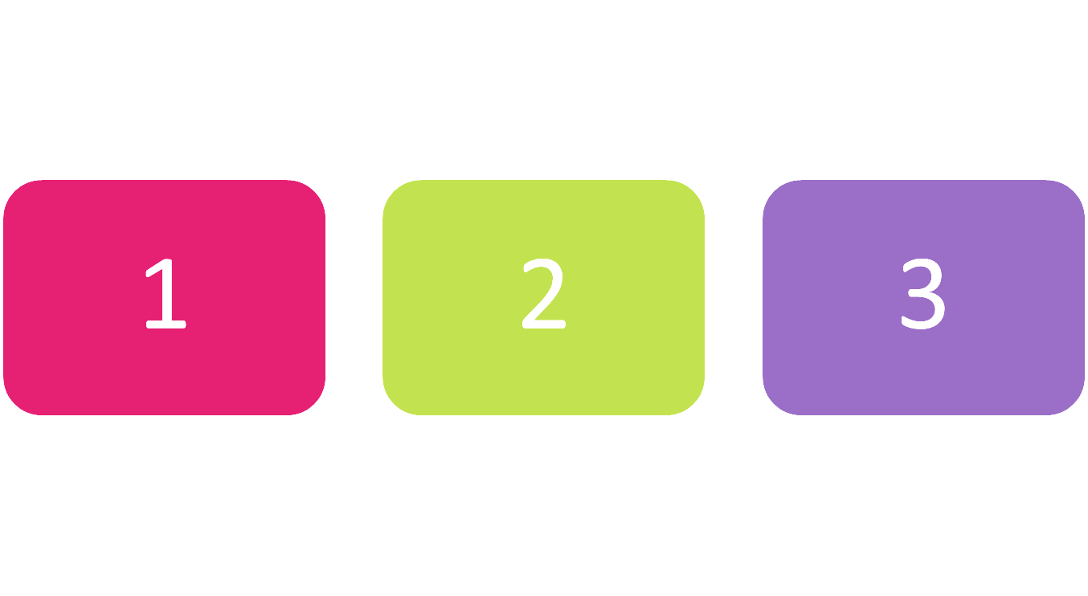
Enumerations
Syntax and Usage

Slide 21
Enumerations
Represent a numeric value from a fixed set as a text
We can use them to pass arguments to methods without making code confusing
By default enums start at 0
Every next value is incremented by 1
enum Day { Mon, Tue, Wed, Thu, Fri, Sat, Sun }
GetDailySchedule(0)
GetDailySchedule(Day.Mon)

Slide 22



Enumerations (2)
We can customize enum values
enum Day {
Mon(1),Tue(2),Wed(3),Thu(4),Fri(5),Sat(6),Sun(7);
private int value;
Day(int value) {
this.value = value;
}
}

Slide 23

Enumerations (2)
We can customize enum values
enum CoffeeSize {
Small(100), Normal(150), Double(300);
private int size;
CoffeeSize(int size) {
this.size = size;
}
public int getValue() {return this.value;}
}

Slide 24

Problem: Hotel Reservation
Create a class PriceCalculator that calculates the total price of a holiday, by given price per day, number of days, the season and a discount type
The discount type and season should be enums
The price multipliers will be:
1x for Autumn, 2x for Spring, etc.
The discount types will be:
None – 0%
SecondVisit – 10%
VIP – 20%
Check your solution here: https://judge.softuni.bg/Contests/955/Working-with-Abstraction-Lab

Slide 25
Solution: Hotel Reservation
public enum Season
{
SPRING(2), SUMMER(4), AUTUMN(1), WINTER(3);
private int value;
Season(int value) {
this.value = value;
}
public int getValue(){
return this.value;
}
}
Check your solution here: https://judge.softuni.bg/Contests/955/Working-with-Abstraction-Lab

Slide 26
Solution: Hotel Reservation
public enum Discount
{
NONE(0), SECONDVISIT(10), VIP(20);
private int value;
Discount(int value) {
this.value = value;
}
public int getValue() {
return this.value;
}
}
Check your solution here: https://judge.softuni.bg/Contests/955/Working-with-Abstraction-Lab

Slide 27
Solution: Hotel Reservation (2)
public class PriceCalculator
{
public static double CalculatePrice(double pricePerDay, int numberOfDays, Season season, Discount discount)
{
int multiplier = season.getValue();
double discountMultiplier = discount.getValue()/ 100.0;
double priceBeforeDiscount = numberOfDays * pricePerDay * multiplier;
double discountedAmount = priceBeforeDiscount * discountMultiplier;
double finalPrice = priceBeforeDiscount - discountedAmount;
return finalPrice;
}
}
Check your solution here: https://judge.softuni.bg/Contests/955/Working-with-Abstraction-Lab

Slide 28

Summary
…
…
…
Well organized code is easier to work with
We can reduce complexity using Methods, Classes and Projects
We can refactor existing code by breaking code apart
Enumerations define a fixed set of constants
Represent numeric values
We can easily cast enums to numeric types

Slide 29
https://softuni.bg/csharp-oop

Slide 30
SoftUni Diamond Partners

Slide 31
SoftUni Organizational Partners

Slide 32




Trainings @ Software University (SoftUni)
Software University – High-Quality Education and Employment Opportunities
softuni.bg
Software University Foundation
http://softuni.foundation/
Software University @ Facebook
facebook.com/SoftwareUniversity
Software University Forums
forum.softuni.bg

Slide 33

License
This course (slides, examples, demos, videos, homework, etc.) is licensed under the "Creative Commons Attribution-NonCommercial-ShareAlike 4.0 International" license

